Slide 1

Introduction to Python using Data Analytics
Lecture
by Mr Koh
Copyright © 2019 by Singapore Institute of Management Pte Ltd. All rights reserved.

Slide 2

Lecture Outline
Basic Statistic Concepts
Introduction to Python Programming
Introduction to Data Visualization

Slide 3
Finding Relations in Data
Regression can be used to predict values
Simple linear regression is a type of regression technique
Can be used to find the best fit line for 2 variables
Using similar concept with equation of a line: y = mx + c
Can predict a value given the other
E.g. predict y value using m and c given x

Slide 4
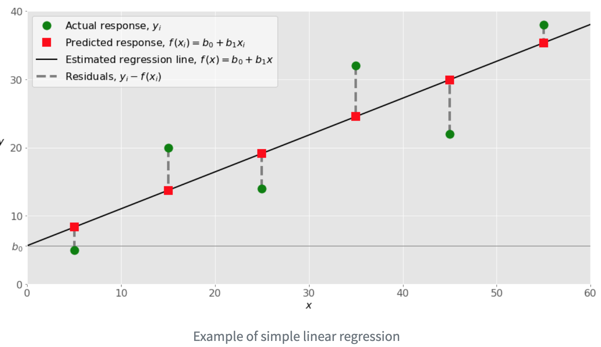
Simple Linear Regression
Source: Google Images

Slide 5
Lecture Outline
Basic Statistic Concepts
Introduction to Python Programming
Basic Concepts
Reading a File
Simple Linear Regression in Python
Introduction to Data Visualization

Slide 6

Python
Python is a programming language
Considered high-level
Many programming concepts are omitted
Simple and straightforward
Suitable for students without programming background
Source: Google Images

Slide 7
Setting up Python Environment
For Windows, the steps are:
1) Install python 3.7.3 (25 March 2019)
2) install Wing Personal 7.0.3
3) Edit Environment variables to include Python37 and Python37/scripts
4) Run the following commands in command prompt:
python -m pip install -U pip setuptools
python -m pip install matplotlib
python -m pip install scikit-learn

Slide 8
Some Setting Up Tips
Note your Python version in your computer
Usually type “python” on your command prompt
If you have prior version of Python, it is a good idea to install a Wing Personal that is compatible
Otherwise, make sure to edit the Environment Variable to include the version of Python you intend to use and install your libraries

Slide 9
Python Hello World
First, let’s get Python to display a text for us
We want to display “Hello World”
In Python, the command to do it is “print” like this:
print(“<some text here>”)
double quotes signify a String (text)

Slide 10
Programming Concepts: Functions
Each function can be treated as number of pre-written line of codes
But the line of codes are “hidden” from the programmer
Do not need to worry about calling the console, you just want to display a piece of text
Example: print(“Hello World”)
print is the function
“Hello World” is the argument/parameter of the function

Slide 11
Function Parameters
You can think of function as a task
But this task is a common task
Argument/parameter are value(s) required for the task
Common tasks but different values
In print(“Hello World”)
The machine knows it must display a text when it sees print
The argument tells the machine to display that text

Slide 12
Practice 1.1 (HelloWorld)
Create a folder in your computer to save your Python files later
Name the folder “PythonWorkshopFiles“
Launch Wing Personal
Click on File -> New
Click on File -> Save as -> Name the file “HelloWorld.py”
Type print(“Hello World”)
And press the green colored Play button in Wing Personal

Slide 13
Practice 1.1 Expected output
Hello World

Slide 14
Programming Concepts: Functions Overriding
Depending on the tasks, more than one value may be required
Same function that accepts one or more argument is known as function overriding
Example:
Display an integer before “Hello World”
print(1, ”Hello world”)

Slide 15
Programming Concepts: Loops
What if we want to display “Hello World” for 12x times?
One way is to write the same code 12x times
Why not write it once and tell the program to do it 12x times?
Loops are used if you want to run the same code over and over again

Slide 16
Loops Example: For
Think of the phrase: “for 12 times, run the same code”
In Python, this can be written in this format:
for <initialization> in <range>(min, max)
The program will run starting from min and ending in max-1
Example:
for x in range (0,12):
print(”Hello world”)
This will print ”Hello World” where x = 0 to x = 11

Slide 17
Printing the Variable X
In a For loop, the variable x gets incremented each time it execute a line of code within the loop
You can print out the value of x preceding “Hello World” as follows:
for x in range (0,12):
print(x, ”Hello world”)
Python will automatically join x and “Hello World” as a String

Slide 18
Manipulating Variable X
However, when you print x, it will starts from 0 and ends at 11
What if you want it to display from 1 to 12?
Solution:
for x in range (0,12):
print(x+1, ”Hello world”)

Slide 19
Programming Concepts: Indentation
Programming language are written by human for human to instruct a machine
It is important that it is intuitive and easily understood by human
If there are many lines of codes, it can be difficult to understand
Indentation promotes neatness in your code
Example:
for x in range (0,12):
print(x, ”Hello world”)

Slide 20
Practice 1.2 (For Loop)
In the same file “HelloWorld.py”, write a For loop to display “Hello World” 12x times
Print out the number each time “Hello World” is printed. The expected output is as follows:
Example: 1. Hello World
2. Hello World
…
12. Hello World

Slide 21
Programming Concepts: Data Types
Integer: numerical integer values e.g. 1,2,3
String: series of characters enclosed in double quotes “” e.g. “Hello World”
Boolean: a true/false variable e.g. True,False
Floating-point numbers: numerical real values e.g. 1.2, 1.3, 1.4

Slide 22
Programming Concepts: Variables
Need to tell the program to store values
e.g. the file you want to refer to, contents of the file
Variable assignment is denoted by =
myVariable = “HelloWorld”

Slide 23
Python Data Types
In Python, you do not need to declare the data type during variable initialization
Example:
myString = “HelloWorld”
myInteger = 123

Slide 24
Programming Concepts: Arrays
Array has multiple values of the same data type
Can be thought of as a matrix or vector
Similar to: [1,2,3,4,5]
To access a particular element in an array
array[<index>]
Index of an array always starts from 0
Index 0 represent the first element in the array
Size of array – 1 represent the last element in the array

Slide 25
Python Arrays
Initialization examples:
myArray = []
Storing Strings: myArray = [“My”, “Array”]
Storing integers: myArray = [1,2,3,4,5]
Iterating values in an array:
for x in myArray:
print(x)

Slide 26
Python Arrays Size
In Python, arrays size are not fixed
Elements can be added into an array using append()
It is added to the end of the array
Example:
myArray = [1,2,3,4,5]
myArray.append(6)
myArray now contains [1,2,3,4,5,6]

Slide 27
Practice 1.3 (Arrays)
Create a new Python file named “ArrayPractice.py”
Create two array to store the following values
“This”, “Is”, “An”, “Array”
2, 3, 4, 5, 6
Append the value 7 to array b.
Use a loop to iterate and print array a. followed by b.

Slide 28
Practice 1.3 Expected Output
This
Is
An
Array
2
3
4
5
6
7

Slide 29
Lecture Outline
Basic Statistic Concepts
Introduction to Python Programming
Basic Concepts
Reading a File
Simple Linear Regression in Python
Introduction to Data Visualization

Slide 30
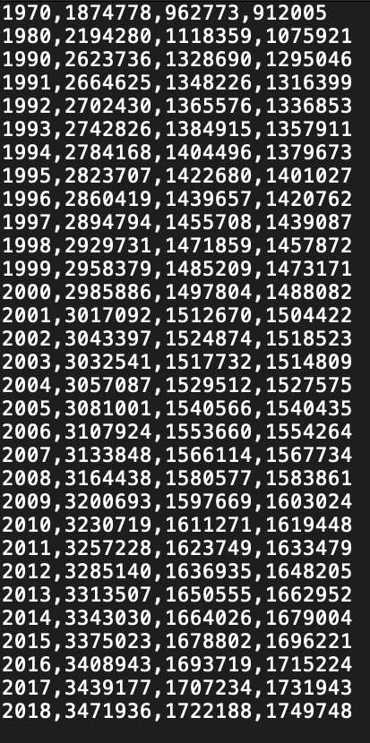
Comma-separated Values (CSV)
A text file with .csv format
Values are separated by commas “,”
Example:
1970 | 1874778 | 962773 | 912005
1980 | 2194280 | 1118359 | 1075921
1990 | 2623736 | 1328690 | 1295046
1970 | 1874778 | 962773 | 912005
… | … | … | …
2018 | 3471936 | 1722188 | 1749748

Slide 31
Reading Files In Your Python Script
To read a file in your Python script, make sure it is in the same directory
In this case, your file to be read should be in “PythonWorkshopFiles” folder
Each operating system (OS) refer to file names differently
Advise to name your files without space
E.g. avoid “My File.csv”, use “MyFile.csv”

Slide 32
Checking for File Extension
Check whether file extension is shown for your files in your OS
If it is not, you should name your file “MyFile” in your OS
but your Python script you should refer to it as “MyFile.csv”
If extension is shown for your files
Just name your file “MyFile.csv”

Slide 33
Programming Concepts: Libraries
Different users have different needs
Some requires calculations
Some requires visualizations
Most programming language are modular
Customize what you need
Libraries contains additional functions that can be used together with standard features

Slide 34
Libraries Functions
Functions from a library are called using ‘.’
Example:
io.open()
csv.reader()

Slide 35
Programming Concept: Commenting
In programming, it is useful to comment
So that others can better understand what you trying to do
Comments are not executed
In Python, commenting is done using #
Example:
#this is a comment

Slide 36
Importing CSV
To display the content of a .csv file, need two libraries
io library – io stands for input/output, used to work with files
csv library – used to work with csv file
To use the libraries in your code, write:
import csv
import io

Slide 37
Steps of Reading a File
Open the file
This is to ensure no other process is accessing it
Also to define whether the file is opened for reading or writing
Read the file
Read the content into a variable or array

Slide 38
Reading Content from File
Open the file:
fileToOpen = io.open('TotalCitizenYear.csv', 'r', encoding='utf-8-sig’)
fileToOpen is a variable, open() is a function from io library, ‘r’ represent reading mode, utf-8-sig represent the encoding
Read the file
inputFile = csv.reader(fileToOpen, delimiter=',’)
inputFile is an array[], reader() is a function from csv library, delimiter represent how values are separated in the file

Slide 39
Variable for Reading File
inputFile is an 2 dimensional array
It contains <number of rows> x <number of values per row>
Imagine: ([1, 2, 3],
[2,3,4],
[4,5,6],
…
[7,8,9])

Slide 40
Reading Files Using Loops
Using loops, you can iterate the number of rows and display the content of each row
Example:
for row in inputFile:
print(row)
To access a particular element in a row
row[<index>]

Slide 41
Practice 1.4 (File Reading)
Create a Python script named “FileReader.py”
Drag the file “TotalCitizenYear.csv” into the same directory as “FileReader.py”
Open the file “TotalCitizenYear.csv” and display the contents within using Python
Add two appropriate comments in your code right before opening and right before reading the file

Slide 42
Practice 1.4 Expected Output
['1970', '1874778', '962773', '912005']
['1980', '2194280', '1118359', '1075921']
['1990', '2623736', '1328690', '1295046']
…
['2018', '3471936', '1722188', '1749748']

Slide 43
Data Analytics Concept: Data Extraction
Data can come in many format
Need to know what each column and row represent
Need to extract the relevant columns for your needs
Luckily, most public data are often structured
However, some data are unstructured like social media messages

Slide 44
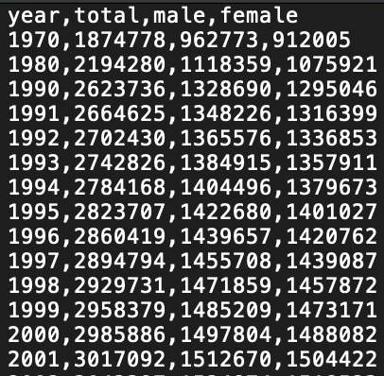
Programming Concept: IF Statements
Sometimes you want to check for specific conditions before executing a piece a code
Example: a .csv file with headers included
How to write a loop that is only interested with the values and not the headers?

Slide 45
IF Statements
IF statement can be used to check for headers
Example:
if row[0] == “year”:
Make sure to end the statement with “:”
“==” is a comparison operator, it allows checking if the first element of a row is the String “year”

Slide 46
IF Statements: Multiple Conditions
Sometimes you want to check if more than one condition are met
Example:
if row[0] == “year” and row[1] == “total”:
The word “and” will allows checking of both conditions before executing the code

Slide 47
ELSE IF and ELSE Statements
You can also define multiple conditions that execute different line of codes
else if is represented by “elif”
A default line of code can be under “else”
Example:
if row[0] == “year”:
<do something>
elif row[0] == “1970”:
<do something>
else:
<do something>

Slide 48
Practice 1.5 (IF Statements)
Make a copy of “FileReader.py” and rename it as “IFStatement.py” in the same directory
Drag the file “TotalCitizenWithHeaders.csv” into the same directory
Use IF statements to check for “year” and “total” and ”male” and “female” in the header row
Try to achieve the expected output

Slide 49
Practice 1.5 Expected Output
Header row: ['year', 'total', 'male', 'female']
This is the first row after header: ['1970', '1874778', '962773', '912005']
['1980', '2194280', '1118359', '1075921']
['1990', '2623736', '1328690', '1295046']
['1991', '2664625', '1348226', '1316399’]
…
['2018', '3471936', '1722188', '1749748']

Slide 50
Lecture Outline
Basic Statistic Concepts
Introduction to Python Programming
Basic Concepts
Reading a File
Simple Linear Regression in Python
Introduction to Data Visualization

Slide 51
Python Library for Statistics
Two libraries are required
import numpy as np
from sklearn.linear_model import LinearRegression
If you only need a specific subset of a library, you can use the word “from”
Example: from sklearn.linear_model import LinearRegression
Translate to import LinearRegression library from sklearn.linear_model

Slide 52
LinearRegression Library
LinearRegression library need special set of arrays
Use their function array()
E.g. y = np.array([5, 20, 14, 32, 22, 38])
Need two set of arrays
x values for rows and y values for columns
But the x values we need to be:
[1,
2,
3]

Slide 53
Reshaping Arrays
LinearRegression library provide a function reshape()
Allows an array to be organized differently
Example:
x = np.array([5, 15, 25, 35, 45, 55]).reshape(-1,1)

Slide 54
Fitting X and Y Values
Need to find the best fit line for the x y values
Achieved by using the fit() function
Eg. model = LinearRegression().fit(x,y)
model is a variable

Slide 55
Data Analytics Concept: Models
After fitting the x and y values
Gradient/slope and intercept are obtained
Resulting values of the fitting like slope and intercept are collectively known as the model
Example:
print('intercept:', model.intercept_)
print('slope:', model.coef_)

Slide 56
Predicting Values using Models
After you are content with the model
You can use it to predict values
Example
x_new = np.array([1,2,3,4,5]).reshape(-1,1)
y_new = model.predict(x_new)
print(y_new)

Slide 57
Practice 1.6 (Linear Regression)
Create a Python file named “LinearRegression.py” and initialize two arrays using np.array() function:
x-values: [5, 15, 25, 35, 45, 55] (remember to reshape it)
y-values: [5, 20, 14, 32, 22, 38]
Find the resulting model and display the slope and intercept values
Initialize and reshape a new set of x-values [1,2,3,4,5]
Predict the set of new y-values, given these new x-values, using the model in 2. and display the new y-values

Slide 58
Practice 1.6 Expected Output
intercept: 5.633333333333329
slope: [0.54]
[6.17333333 6.71333333 7.25333333 7.79333333 8.33333333]

Slide 59
Lecture Outline
Basic Statistic Concepts
Introduction to Python Programming
Introduction to Data Visualization
Line graphs
Boxplots
Bar chart

Slide 60

Public Data
The official portal for public data in Singapore is data.gov.sg
Has things like birth rate, resident by area etc.
Source: data.gov.sg

Slide 61
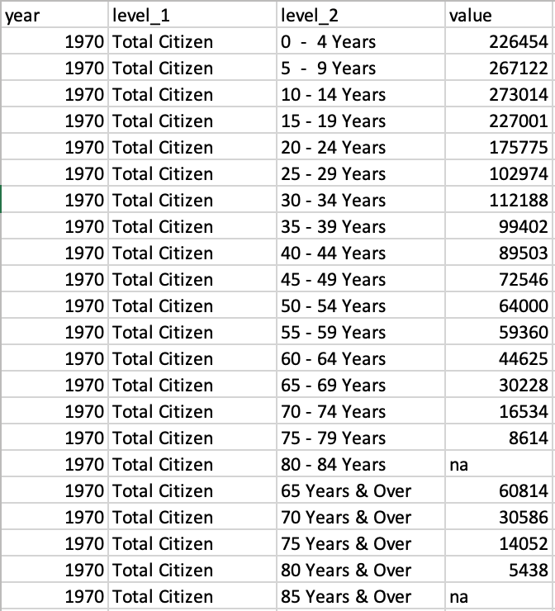
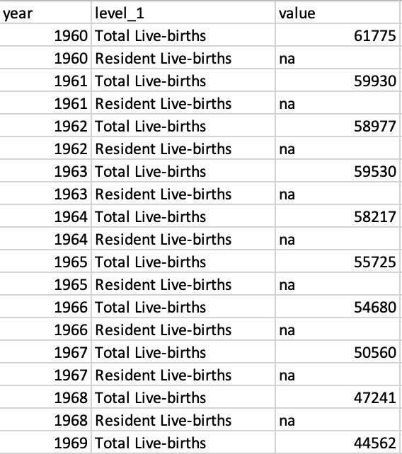
Example Dataset
Annual Live Births
Annual Total Citizen by Age, Ethnic and Gender

Slide 62
Python Visualization Library
The library we are using is Matplotlib
It contains some basic visualization functions
Basic steps:
Import the library
Open the file containing the data
Store the contents of the file
Plot the contents of the file

Slide 63
Renaming Library for Use in Code
Sometimes the name of the library can be long
You can rename the library to be used in your code
Example:
import matplotlib.pyplot as plt
The word “as” will rename the library
Each time calling matplotlib.pyplot.<function>() vs plt.<function>()

Slide 64
Programming Concept: Type Casting
Program need to know the data type of variables
When the content is read from file
By default is String
Can cast it to integer, floating-points numbers etc.
Achieved by enclosing the variable you wish to cast
Example: int(<variable>)

Slide 65
Using Matplotlib
Plot the values:
plt.plot(<xValue>,<yValue>,<color and style>)
Example:
plt.plot(totalYear,totalCitizen,'g--’)
totalYear and totalCitizen are arrays of values of the same size and each element must be integer data type
‘g’ stands for green color
‘--’ means the line graph will be drawn using dash ‘-’

Slide 66
Programming Concept: Type Casting
When the content is read from file
It is stored as a String
Can cast it to integer, floating-points numbers etc.
Achieved by enclosing the variable you wish to cast
Example: int(<variable>)
int(row[0])

Slide 67
Multiple Line Graphs in a Chart
You can have multiple line graph in one chart by overriding the plot() function
Example:
plt.plot(totalYear,totalCitizen,'g--', totalYear, totalMale, 'b--', totalYear, totalFemale, 'r--’)
‘b’ stands for blue color and ’r’ stands for red color

Slide 68
Setting Up the Plot
Setup the plot:
Give the x-axis a name: plt.xlabel('year')
Give the y-axis a name: plt.ylabel('value')
Give the line graph a name: plt.title('Total Citizen by Gender and Year’)
Display the plot:
plt.show()

Slide 69
Practice 1.7 (Line Graph)
Create a Python file named “LineGraph.py”
Initialize four empty arrays named “totalYear”, “totalCitizen”, “totalMale” and “totalFemale” to store the respective values
Read the file “TotalCitizenYear.csv” and store corresponding values into the arrays you created in 2.
Remember to cast your values into integer before storing them
Plot out the graph of total citizen (green), total male (blue) and total female (red) against year

Slide 70
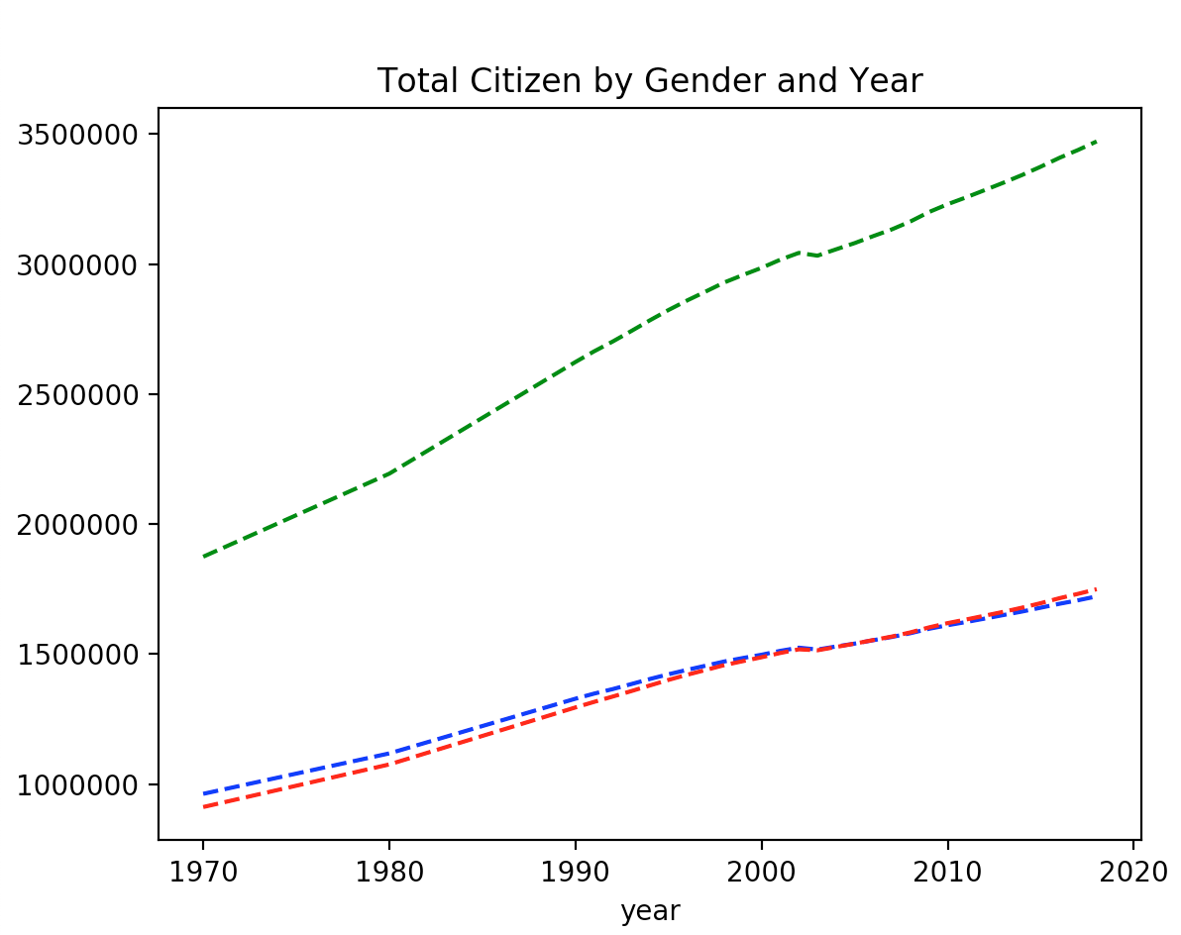
Practice 1.7 Expected Output

Slide 71
Lecture Outline
Basic Statistic Concepts
Introduction to Python Programming
Introduction to Data Visualization
Line graphs
Boxplots
Bar chart

Slide 72
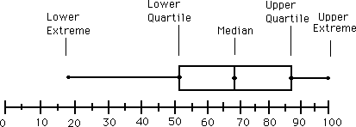
Summarizing Data
Quartiles and boxplots:
Quartiles: Q₁ (25th percentile), Q₃ (75th percentile)
Five number summary: min, Q₁, median, Q₃, max
Source: Google Images

Slide 73
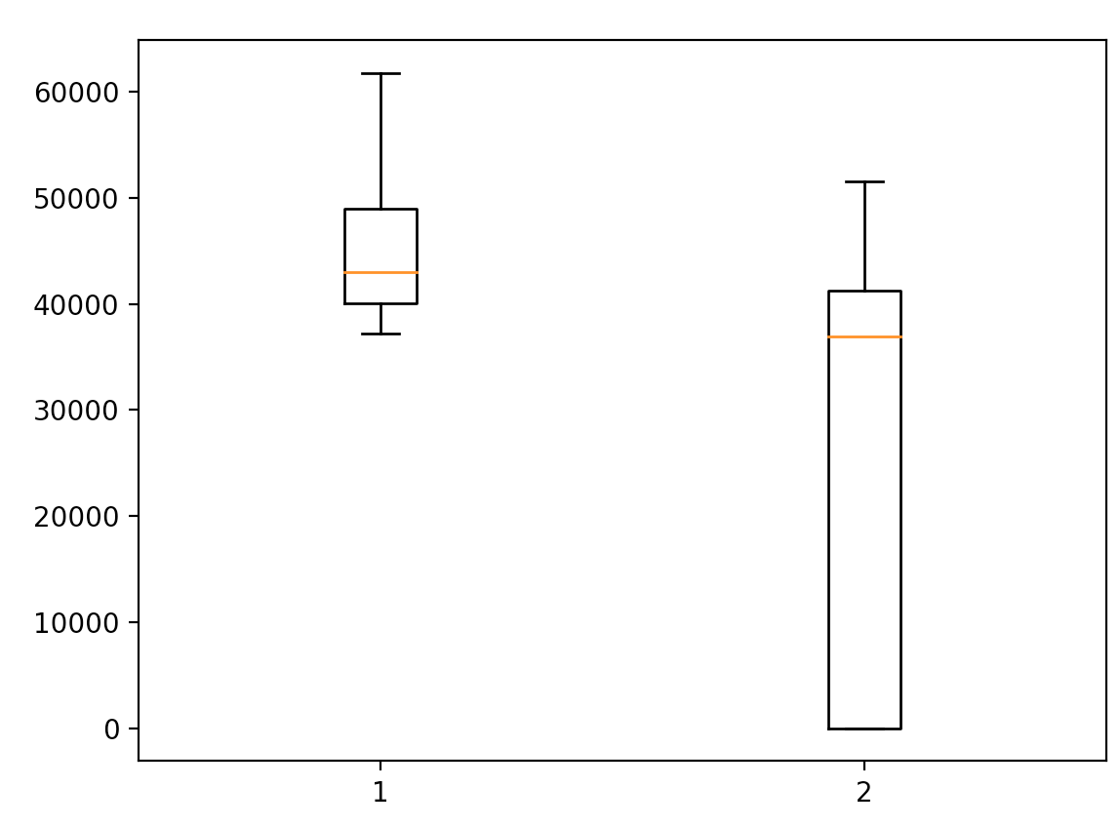
Summarising Data with Boxplot
Data is represented with a box
The ends of the box are at the first and third quartilesThe median is marked by a line within the box

Slide 74
Boxplot in Python
Can use plt.boxplot() function
Takes in an array of one or more arrays
Example:
smallArray1 = [1,2,3,4,5]
smallArray2 = [6,7,8,9,10]
myArray = [smallArray1, smallArray2]
plt.boxplot(myArray)
plt.show()

Slide 75
Practice 1.8 (Boxplot)
Create a Python file named “Boxplot.py” and read the file “LiveBirthYear.csv”
Plot out two boxplots, one for total resident live birth and the other for total live birth
Make sure to check for “na” values, whether a particular row is meant for total live or total resident live births and check for header rows

Slide 76
Practice 1.8 Expected Output

Slide 77
Lecture Outline
Basic Statistic Concepts
Introduction to Python Programming
Introduction to Data Visualization
Line graphs
Boxplots
Bar chart

Slide 78
Bar Charts
Simple to read
Can easily see the percentage of live birth from residents
Not so good at visualizing events with trends
Examples suitable to be visualized by Bar Charts
Residents by age group
Residents by ethnic group
Residents by age group and gender

Slide 79
Bar Charts in Matplotlib
Uses the function plt.bar()
Example:
plt.bar(liveBirthYear,totalLiveBirth, color=’g’)
liveBirthYear is an array containing all the years
totalLiveBirth is an array containing all the live births
‘g’ represent green color

Slide 80
Multiple Bar Charts
Always good practice to use different arrays for different bar charts
Example:
plt.bar(liveBirthYear,totalLiveBirth, color='g')
plt.bar(residentLiveBirthYear, totalResidentLiveBirth, color='b’)
‘b’ stands for blue color

Slide 81
Showing Bar Charts
Same as line graphs, you can customize the bar charts
Setting up:
plt.xlabel('year')
plt.ylabel('value’)
Display:
plt.show()

Slide 82
Practice 1.9 (Bar Chart)
Create a Python file named “Barchart.py” and read the file “LiveBirthYear.csv”
Plot out two bar charts, one for total resident live birth (blue) and the other for total live birth (green)
Make sure to check for “na” values, whether a particular row is meant for total live or total resident live births and check for header rows

Slide 83
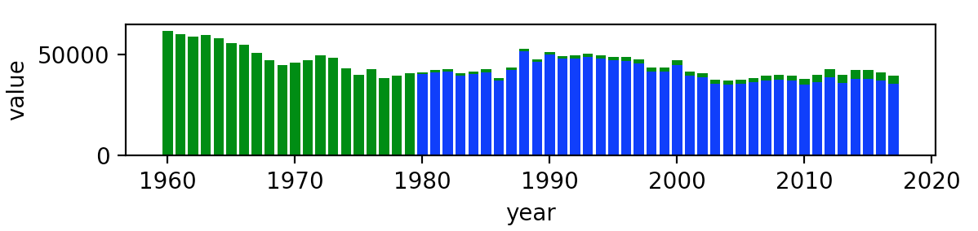
Practice 1.9 Expected Output

Slide 84
Self Test
Create a Python file named “SelfTest.py” and read the file “TotalCitizen.csv”
Plot out a bar chart showing the total female citizen aged 40-44 in red color

Slide 85
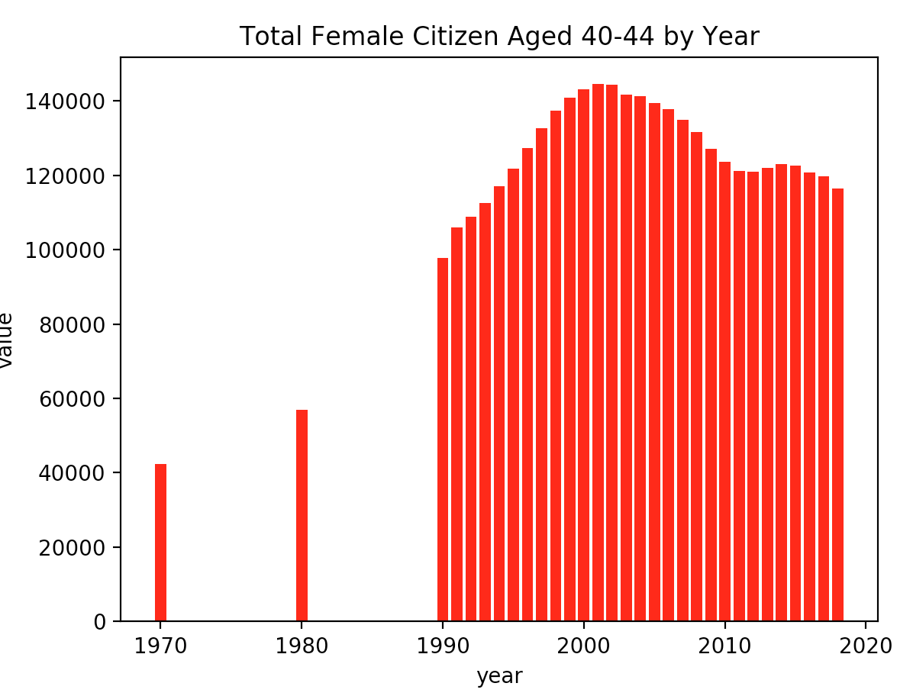
Self Test Expected Output

Slide 86
End of Workshop

